Slide 1
TIP TO TIP- Navigating the world of white canes

Slide 2
Agenda
Topics
Intro to O&M and ADL
What is a white cane? How can it be used?
How can I measure a white cane?
What are the different white cane materials?
What are the different long cane tips
Do you have to be mobile to use a white cane?
Conclusion/Q&A

Slide 3
Intro to O&M and ADL
Orientation & Mobility (O&M)
Activities of Daily Living (ADL)
A specialized service for people with visual impairments, designed to teach them how to navigate their environment as safely and independently as possible.
The fundamental skills people with visual impairments need to perform everyday tasks for independent living and self-care.
Ex: Cooking, cleaning, & riding the bus.

Slide 4
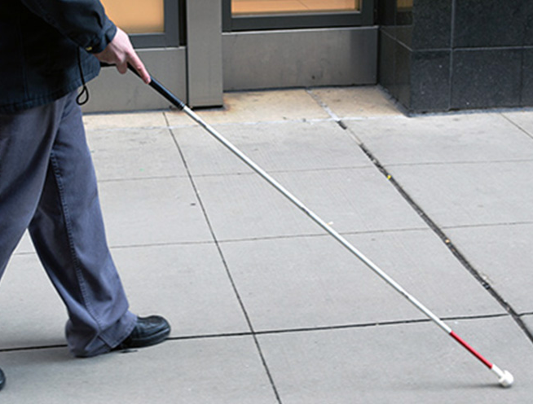
What is a white cane? How can it be used?
A white cane is a red and white, all white, or all red slender cane with a tip attached. The tip on the cane depends on the terrain the person travels on most.
A white cane can be used as identification to others that you are visually impaired, can be used to locate drop-offs or changes in terrain, and can be used to explore the environment.

Slide 5

How to measure a white cane?
The cane is measured in inches. If you are purchasing your cane from ambutech.com, the cane is measured in even increments to the armpit or sternum.
If the cane is coming from the National Federation of the Blind, the cane is measured in odd increments to the tip of your nose.

Slide 6
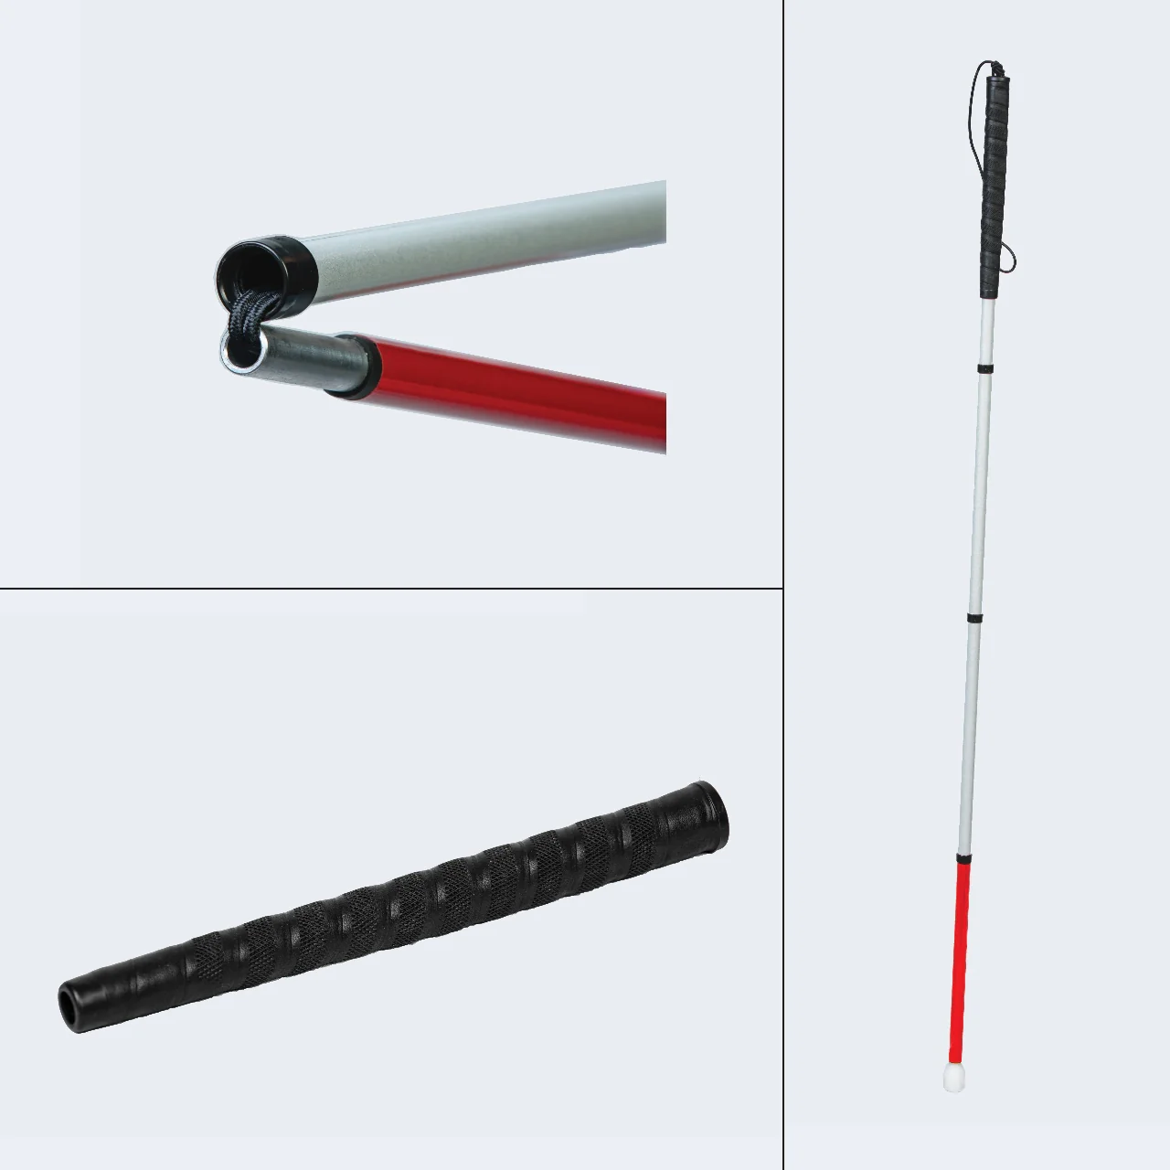
What are the different white cane materials?
Fiberglass, the lightest and thickest.
Graphite, the medium, but still light and the thinnest.
Aluminum, the heaviest and has a medium thickness.

Slide 7
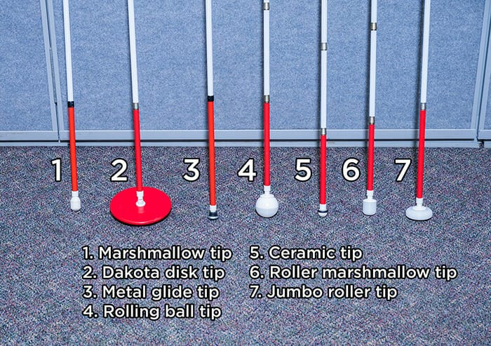
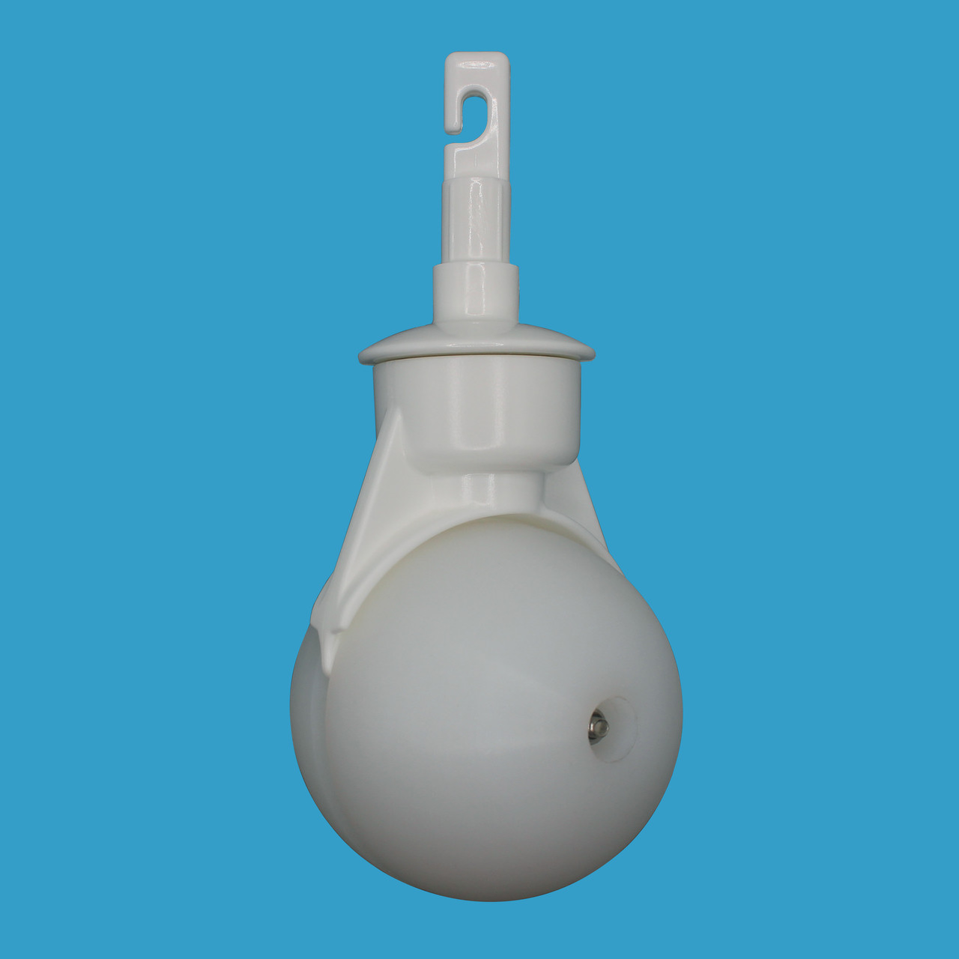
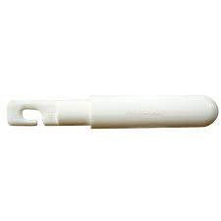
What are the different cane tips?
The image has the fan favorites, but some honorable mentions are the path finder cane tip and the pencil cane tip.

Slide 8
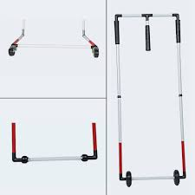
Do you have to be mobile to use a white cane?
Absolutely not! We can use other types of white canes, like an Adaptive Mobility Device (AMD), or modify the skills to best suit your needs.

Slide 9

Questions?

